Slide 1
Capstone Engagement
Assessment, Analysis, and Hardening of a Vulnerable System

Slide 2
Table of Contents
This document contains the following sections:
01
Network Topology
02
Red Team: Security Assessment
03
Blue Team: Log Analysis and Attack Characterization
Hardening: Proposed Alarms and Mitigation Strategies
04

Slide 3
Network Topology
‹#›

Slide 4
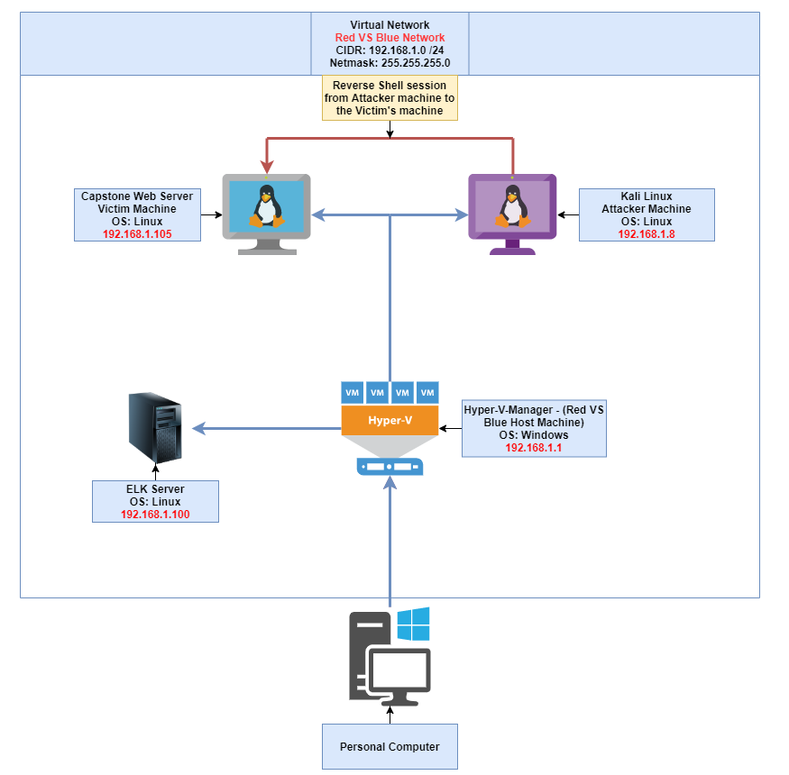
Network Topology
Network
Address Range: 192.168.1.1 - 192.168.1.254
CIDR: 192.168.1.0 /24
Netmask: 255.255.255.0
Gateway: 192.168.1.1
Machines
IPv4: 192.168.1.1
OS: Windows
Hostname: Red Vs Blue
IPv4: 192.168.1.105
OS: Linux
Hostname: Capstone
IPv4: 192.168.1.8
OS: Kali Linux
Hostname: Kali
IPv4: 192.168.1.100
OS: Linux
Hostname: ELK
[Insert Here]
Use draw.io to create a diagram of the network.
Add your diagram to this slide and fill out the data in the sidebar.
The image is too big for this slide obviously! I have a link to my Github page where the diagram can be seen much easier. Link: https://github.com/Calvin-A-Cyber/University-of-Denver-Course-Work/blob/main/Images/Diagrams/Red%20Team%20VS%20Blue%20Team.drawio.png

Slide 5

Red Team
Security Assessment
‹#›

Slide 6
Recon: Describing the Target
Nmap identified the following hosts on the network:
Hostname | IP Address | Role on Network
Red VS Blue | 192.168.1.1 | This is the VM that is running Hyper-V-Manager, allowing us to access the Capstone and Kali machines.
ELK Stack Machine | 192.168.1.100 | This machine is the ELK Stack (Elastic search, Logstash and Kibana) that collects the logs, sorts them and displays them in Kibana.
Kali | 192.168.1.8 | This is the attacker machine that I used to run all exploits against the Capstone machine.
Capstone | 192.168.1.105 | This is the vulnerable machine I ran all exploits against and had some fun while doing it.

Slide 7
Vulnerability Assessment
The assessment uncovered the following critical vulnerabilities in the target:
Vulnerability | Description | Impact
Use the CVE number if it exists. Otherwise, use the common name. | Describe the vulnerability. | Describe what this vulnerability allows the attacker to do.
Exploitation: Terrible Website Security (CWE-23: Relative Path Traversal) | This exploit did not require any tools. The “web devs” left an easter egg in file1.txt that there is a hidden directory called /secret_folder/….terrible web security! | If the web dev team did not leave this easter egg, then I could have just used a tool like dirb to find the hidden directory, but by having this hidden directory they are setting themselves up to be attacked.
Exploitation: Hydra Brute Force Attack (CVE-2021-XXXX) | This exploit I used the hydra command to launch a Brute Force Attack on the site for the credentials to login into the /secret_folder/ directory. | This allowed me to obtain the credentials to login into the /secret_folder/, which ultimately allowed me to launching an attack on the site via a reverse shell.
Exploitation: Reverse Shell (CVE-2019-13386) | This exploit allows a user to execute a reverse shell with user privileges. | This is a catastrophic vulnerability for an organization or website, every piece of data is at risk, all user credentials are at risk and even the website is at risk because an attack can encrypt all files and shut the website down.
For the first Vulnerability I used a CWE rather than a CVE. The reasoning for this is because I could not find a CVE case for this vulnerability and this is a very general issue (relative path traversal). I use a Google definition to backup my thinking.“ Here's the simple distinction: CWE stands for Common Weakness Enumeration, and has to do with the vulnerability—not the instance within a product or system. CVE stands for Common Vulnerabilities and Exposures, and has to do with the specific instance within a product or system—not the underlying flaw”
Website used for research: https://danielmiessler.com/blog/difference-cve-cwe/

Slide 8
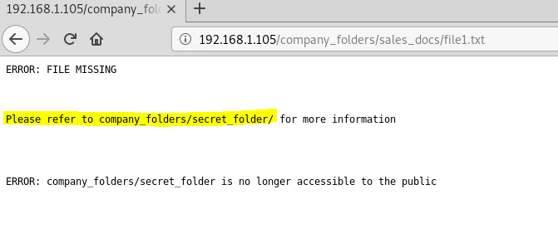
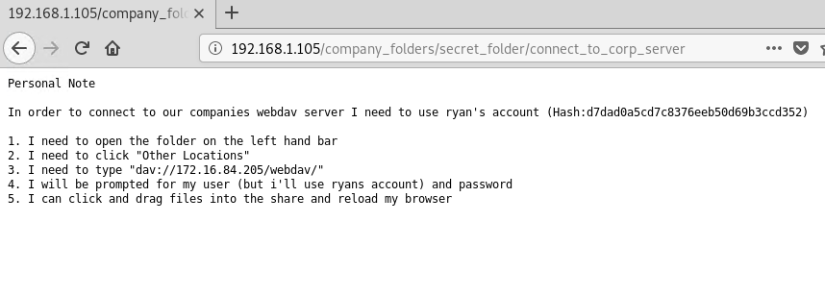
Exploitation: Terrible Website Security (CWE-23: Relative Path Traversal)
01
02
03
Tools & Processes
Answer: No tools were needed to find this exploit. While navigating around the site I clicked on file1.txt and the output referred to a /secret_folder/ for more information. This was deliberately referring to a directory that a normal user should not be able to access and how to navigate to the directory.
Achievements
Answer: This exploit led me to navigate to the /secret_folder/ which then led me to find the /webdav/ directory, where I could ultimately launch my attack.
The screenshots do not look great and are hard to read, sorry! I tried my best, but you can just drag the screenshot corner to make it big when your grading.
Website used for research found Via Google: https://cwe.mitre.org/data/definitions/23.html

Slide 9
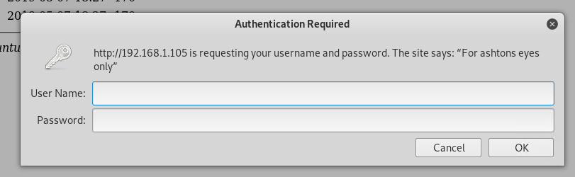
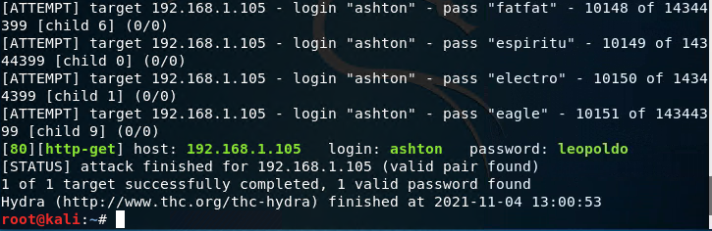
Exploitation: Hydra Brute Force Attack (CVE-2021-XXXX)
01
02
03
Tools & Processes
Answer: The tool that I used to achieve this vulnerability was Hydra. Hydra uses a wordlist, username, victim’s IP address and a specified port to crack a password.
Achievements
Answer: With this exploit I was able to obtain the password for the user Ashton and from there I was able to login into the /secret_folder/ directory that was found on the site. Once I was in the /secret_folder/ directory I was shown a series of instructions to access the /webdav/ directory as well as a password hash to crack to gain access to the directory.
Command: hydra -l ashton -P /usr/share/wordlists/rockyou.txt -s 80 -f -vV 192.168.1.105 http-get /company_folders/secret_folder
The screenshots do not look great and are hard to read, sorry! I tried my best, but you can just drag the screenshot corner to make it big when your grading.
Website used for research found Via Google: https://cve.mitre.org/cgi-bin/cvekey.cgi?keyword=brute+force+rdp
I could not find the exact CVE number for the exploit, I went through a few hundred and could not determine which one was correct. But the CVE class 2021 is for Brute Force attacks so it is within the CVE-2021 range but I am not sure which exact attack it is numbered (last four digits).

Slide 10
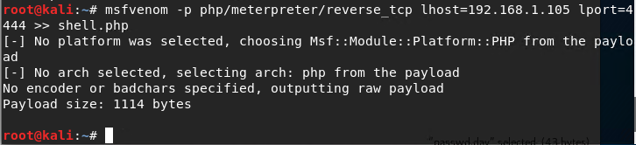
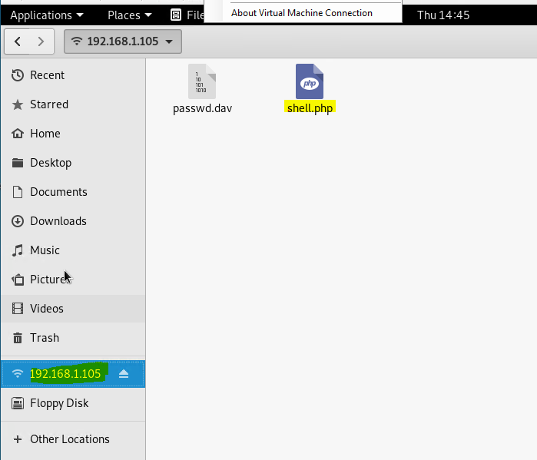
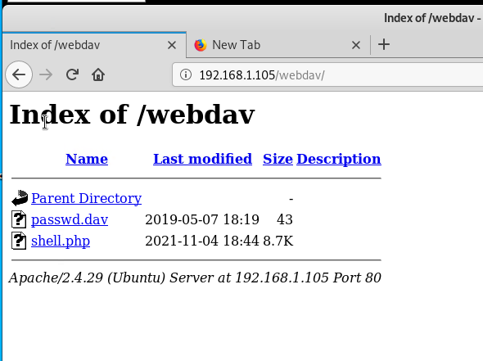
Exploitation: Reverse Shell (CVE-2019-13386)
01
02
03
Answer: The last exploit was establishing a meterpreter session on the site with a reverse shell. This way a 2 step process. First we accessed the /webdav/ directory that we cracked the password hash for in the previous step. Once we accessed the /webdav/ directory we uploaded a script file to activate the revershell once it has been opened. Second we set up our Kali machine to wait and listen on port 4444 for the file to be opened. Once the file was opened we achieved a reverse shell into the site.
Achievements
Answer: This exploit was the holy grail of the exercise. We gained full access to the site and user access to all of its files. This allowed us to find the Flag on the site in order to “Capture the Flag”.
The screenshots do not look great and are hard to read, sorry! I tried my best, but you can just drag the screenshot corner to make it big when your grading.
Website used for research found Via Google: https://nvd.nist.gov/vuln/detail/CVE-2019-13386

Slide 11

Blue Team
Log Analysis and Attack Characterization
‹#›

Slide 12

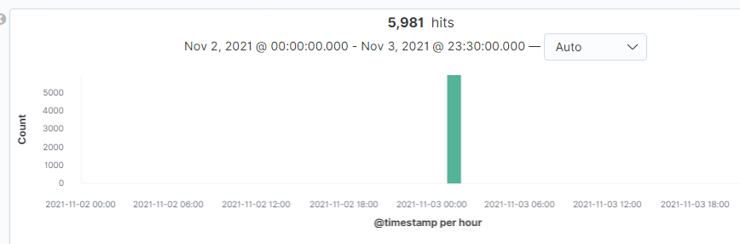
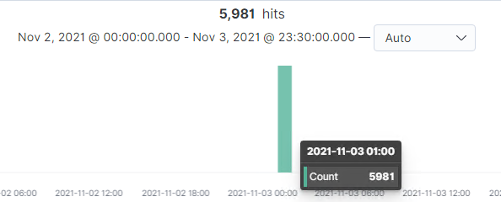
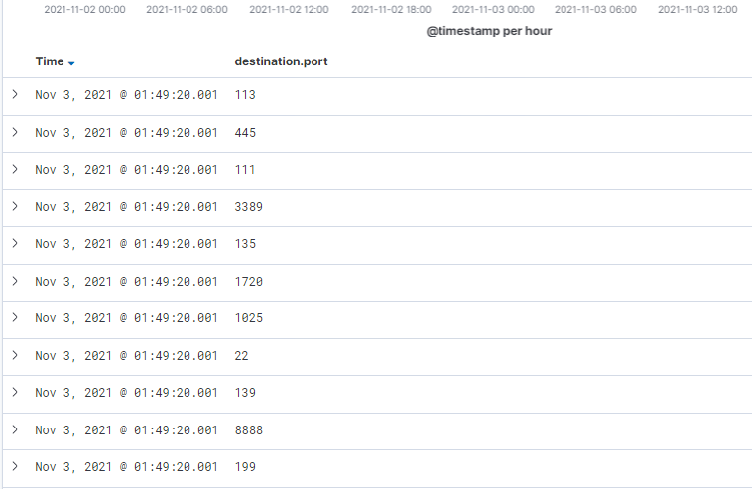
Analysis: Identifying the Port Scan
Answer the following questions in bullet points under the screenshot if space allows. Otherwise, add the answers to speaker notes.
What time did the port scan occur?
How many packets were sent, and from which IP?
What indicates that this was a port scan?
My search Query was: source.ip: 192.168.1.8 AND destination.ip : 192.168.1.105 AND NOT destination.port: 80
What time did the port scan occur?: The port scan occurred at 1 AM on 11/3/2021 as you can see from the screenshot on the right.
How many packets were sent, and from which IP?: 5,981 packets were sent from attacker (Kali) IP address 192.168.1.8 to the victim (Capstone) IP address 192.168.1.105.
What indicates that this was a port scan? What indicates this is a port scan is the screenshot on the bottom left. It is literally showing the packets being sent to each port on the victim's machine in order to see what ports are open, closed or filtered. Fun Fact - The times for each destination port is the exact same for all ports; 01:49:20.001 meaning each port was scanned simultaneously which is consistent for the NMAP scan I ran. Another Fun Fact - If I ran a very slow port scan (and/or a “Quiet” port scan), it would be much harder to detect the port scan since the scan would be so spread out. I go into more depth on this with slide 17.

Slide 13
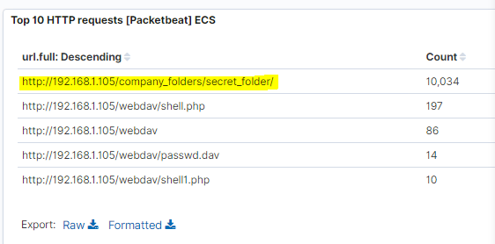
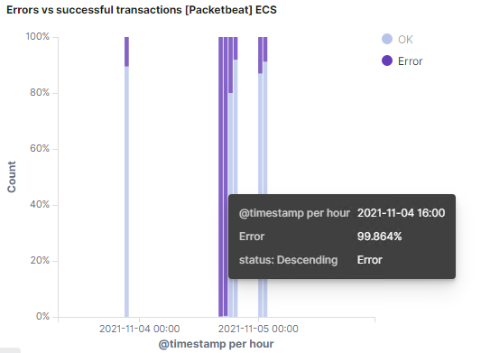
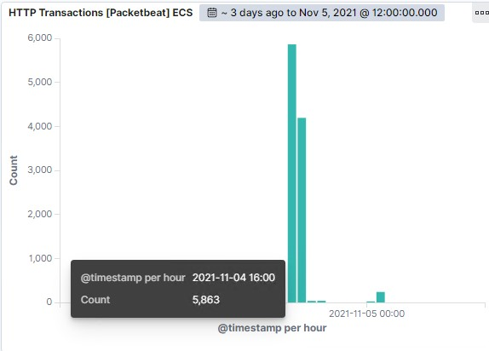
Analysis: Finding the Request for the Hidden Directory
Answer the following questions in bullet points under the screenshot if space allows. Otherwise, add the answers to speaker notes.
What time did the request occur? How many requests were made?
Which files were requested? What did they contain?
What time did the request occur?: The request occurred on 11/4/2021 between 4 PM and 5 PM.
How many requests were made?: 10,034 requests were made to the /secret_folder/. While the other folder /webdav/ and the files within that directory were requested as many times as the screenshot above is displaying above.
Which files were requested?: The files that were requested were, shell.php, passwd.dav and shell1.php. *The files shell1.php was another script I uploaded to see if it would run, it did not work*
What did they contain?: The shell.ph file contained a script to start a reverse shell on server, thus making the server establish a meterpreter session with our system that was listening on port 4444. Shell1.ph contained another slightly different script and the passwd.dav file contained the password for the developers.

Slide 14
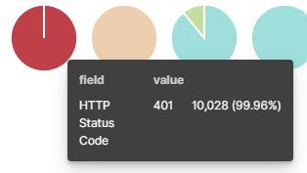
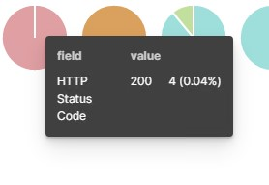
Analysis: Uncovering the Brute Force Attack
Answer the following questions in bullet points under the screenshot if space allows. Otherwise, add the answers to speaker notes.
How many requests were made in the attack?
How many requests had been made before the attacker discovered the password?
How many requests were made in the attack?: During the attack 10,034 requests were made to access the /secret_folder/.
How many requests had been made before the attacker discovered the password?: The number of requests that were made before Hydra cracked the password was 10,0028 requests. Leaving the last 4 attempts as successfully accessing the /secret_folder/ directory.

Slide 15
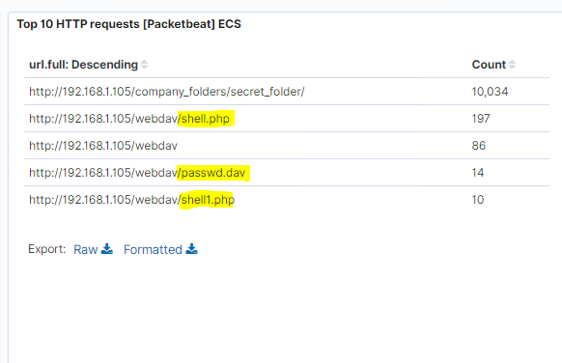
Analysis: Finding the WebDAV Connection
Answer the following questions in bullet points under the screenshot if space allows. Otherwise, add the answers to speaker notes.
How many requests were made to this directory?
Which files were requested?
How many requests were made to this directory?: 86 requests were made to the /webdav/ directory during the attack.
Which files were requested?: As you can see the files requested within that directory were, shell.php, passwd.dav and shell1.php.

Slide 16
Blue Team
Proposed Alarms and Mitigation Strategies
‹#›

Slide 17
Mitigation: Blocking the Port Scan
What kind of alarm can be set to detect future port scans?
Answer: An alarm that can detect future port scans with NMAP needs to be able to identify when SYN-SYN/ACK-RST packets are occurring regularly, because this is a tall tail sign of a port scan. Once, a system identifies that a client is running through different ports and dropping all packets after SYN/ACK in the three-way handshake, then the system can drop all packets from this client.
What threshold would you set to activate this alarm?
Answer: For a system to properly detect a NMAP port scan, a good threshold of 50-100 SYN-SYN/ACK-RST occurrences in 1 hour is a good threshold to start with.
What configurations can be set on the host to mitigate port scans?
Answer: Mitigating simple “loud” port scans that are dropping TCP packets after SYN/ACK are simple, create a firewall rule to drop clients that are continuously not completing the TCP three-way handshake on multiple ports in a short amount of time. As I said in the alarm threshold section 50-100 RST’s on different ports is a good start and work up or down from there based on the amount of alerts. *I continue below with more details to my explanation.*
Describe the solution. If possible, provide required command lines.
Answer: Simply add a firewall rule to drop clients that are continuously not finishing the three-way TCP handshake with the threshold of 50-100 RST’s occurring on different ports in a 1 hour time frame.
To continue on the mitigating a port scan question: Mitigating a port scan with an attacker that is experienced and knows how to run a proper port scan without being detected in the logs can be difficult. An attacker can run a UDP port scan (This does not yield as much info as a TCP scan but is still hard to detect). The attacker could also send NULL packets containing nothing in order to get a RST response or no response from the port, if a port is open it sends back a RST, if it is closed the attacker gets no response, thus telling him what ports are open and closed. Lastly, an attacker can start a TCP three-way handshake with a FIN packet and if the attacker gets no response the port is open and if the attacker gets a RST response the port is closed. This type of port scan tricks the firewall because a firewall is looking for SYN packets, not FIN packets because that would mean the firewall already scanned the initial SYN packets of the client and now it is finishing its handshake with the server with a FIN packet. So, there are many ways to dodge being detected with a port scans in logs, but Wireshark and new IDS/IPS systems can still catch these!
Website used for research: https://www.varonis.com/blog/port-scanning-techniques/
Website used for research: https://www.extrahop.com/company/blog/2016/how-to-recognize-malicious-network-scanning-port-scanning/

Slide 18
Mitigation: Finding the Request for the Hidden Directory
What kind of alarm can be set to detect future unauthorized access?
Answer: An alarm that can be set to detect this unauthorized access is a firewall rule that alerts the system admins anytime a non-authorized (Not whitelisted) IP address attempts to accesses the /secret_folder/.
What threshold would you set to activate this alarm?
Answer: As long as only the authorized IP addresses will have access to this directory the threshold would be 1 time. Since, no one other than the authorized IP addresses should have access to the directory. An alert should be sent if any other IP addresses accesses the folder.
What configuration can be set on the host to block unwanted access?
Answer: A configuration that can be set on the host to block unwanted traffic is to whitelist only internal IP addresses that should have access to the /secret_folder/ directory. Blocking all other unwanted access. With that being said, the best solution would be to delete the /secret_folder/ all together.
Describe the solution. If possible, provide required command lines.
Answer: To add a whitelist for IP addresses a firewall must be in place in order to program the firewall. Then you can program the firewall to only allow specific IP addresses into the directory and block all other IP addresses.

Slide 19
Mitigation: Preventing Brute Force Attacks
What kind of alarm can be set to detect future brute force attacks?
Answer: An alarm to detect a Brute Force attack could be an alert that watches for more than 10 packets for a single user that have a 400 response code in 1 hour. This would mean someone has messed up their own password 10 times in a row in 1 hour or someone is trying to access a user’s account maliciously.
What threshold would you set to activate this alarm?
Answer: The threshold is the toughest part, since it's different for every organization. For this scenario, starting with a threshold of 10, then working down or up depending on the number of alerts being received by the system admins is the safest way to play this threshold.
What configuration can be set on the host to block brute force attacks?
Answer: With our alarm watching for 400 response codes with a threshold of 10 times per hour. After a user or attacker uses up the 10 attempts in 1 hour a system admin will be notified to contact the user. The users account will also be locked until the system admin makes contact with the employee and determines if it is an attack or forgotten password.
Describe the solution. If possible, provide the required command line(s).
Answer: The solution would be to lock the users account until the system admin determines if it was an attack or a case of forgotten password and unlocks the account to be logged into.

Slide 20
Mitigation: Detecting the WebDAV Connection
What kind of alarm can be set to detect future access to this directory?
Answer: An alarm can be set to alert the system admins if a client tried to access the /webdav/ directory from NOT an internal IP address that is authorized (Whitelisted) to access the directory.
What threshold would you set to activate this alarm?
Answer: The threshold similar to accessing the /secret_folder/ would be 1 time. If anyone from an unauthorized IP address is attempting or already has access the /webdav/ directory, there is a problem.
What configuration can be set on the host to control access?
Answer :The best way to mitigate a client/attacker from accessing the /webdav/ directory is to not allow remote access to the directory over the web. This way only internal systems can access and make changes to the directory.
Describe the solution. If possible, provide the required command line(s).
Answer: To implement this solution the System admin team would have to block all connection over the internet via a firewall. Then create a white list of internal IP addresses that can access the server for the system admins to maintain the server.

Slide 21
Mitigation: Identifying Reverse Shell Uploads
What kind of alarm can be set to detect future file uploads?
Answer: An alarm to detect a client trying to upload a reverse shell script can be set to alert all system admins if any file is being uploaded to the site and specifically the /webdav/ directory. This way any file being uploaded to the site will be looked at immediately.
What threshold would you set to activate this alarm?
Answer: The threshold I would use would be 1. If 1 file is uploaded to the /webdav/ file or anywhere on the website from a client the system admins will be notified.
What configuration can be set on the host to block file uploads?
Answer: The best way to mitigate this type of attack is block all clients and users other than the internal system admins from uploading any files to the site. And/Or you can change the /webdav/ directory to not allow script execution in order to still allow file upload, but stop malicious executables from running. But this can be tricky and abused by an attacker.
Describe the solution. If possible, provide the required command line.
Answer: To implement the blocking all files from being uploaded, simply add this security feature into the website and all clients will not be able to upload any files into the site.

